Slide 1
Awesome Resources already available
Purdue University: https://ag.purdue.edu/btny/weedscience/Documents/Rotation_Restrictions.pdf
Penn State University: http://extension.psu.edu/plants/crops/soil-management/cover-crops/herbicide-persistence/herbicide-carryover-table
University of Wisconsin: http://wcws.cals.wisc.edu/new-fact-sheet-herbicide-rotation-restrictions-in-forage-and-cover-cropping-systems/
University of Missouri: https://ipm.missouri.edu/IPCM/2014/9/Influence-of-Corn-and-Soybean-Herbicide-Treatments-on-Cover-Crop-Stands/
University of Nebraska: http://cropwatch.unl.edu/2016/herbicide-options-planting-forage-cover-crops-after-corn-and-soybean
Iowa State University: http://www.weeds.iastate.edu/mgmt/2015/CCherbicides.pdf
Michigan State University: http://msue.anr.msu.edu/news/chemically_terminating_cover_crops

Slide 2
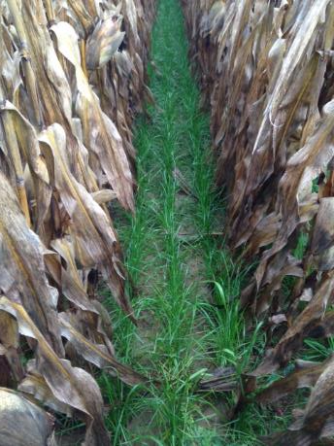
What affects herbicide carryover?
Environment – moisture, temperature, soil type
Soil pH
Herbicide chemistry and application rate
Date of herbicide application
Date of cover crop seeding
Cover crop application method

Slide 3
Growth Regulators
Herbicides used in grass cash crops for broadleaf control
2,4-D – broadleaves can be an issue if planting directly after application, wait 30 days
Dicamba (Clarity, Banvel) – wait 120 days – usually not a problem
Clopyralid (Stinger, SureStart) – can be an issue with legumes
Triclopyr & quinclorac – noticed a couple issues with legumes

Slide 4
PPO Inhibitors
Herbicides used primarily in soybeans for broadleaf control
Sharpen – no real concerns; short plant-back restriction
Flexstar, Reflex – shorter half life; still see issues in radish, rapeseed, and clovers
Cobra, Phoenix – slight concern for brassicas
Spartan (Authority) – most issues are with brassicas and small seeded legumes, cereal grains too
Valor – legumes can have problems; brassicas to a lesser degree

Slide 5
Triazines
Herbicides used in corn, soybeans, and a wide range of cash crops
Atrazine, simazine (Princep), metribuzin (Sencor)
Atrazine, Princep generally cause some concern for legumes; limited issues for grasses and cereal
Sencor doesn’t cause issues in grasses, but we have seen some clover injury
Lower rates mean more flexibility
High pH soils increase the concern

Slide 6
ALS Inhibitors
Herbicides used in corn and soybeans for broadleaf control
Raptor, Pursuit, Classic, FirstRate, Permit, Resolve Q, Python, Peak, Harmony, many others
Classic – more persistent in high pH soils
Pursuit – always been an issue (longer soil activity); brassicas, legumes, and even oats don’t work well typically after Pursuit
Raptor, FirstRate – longer soil activity (Raptor more sensitive in acidic soils)
Resolve Q – zero issues so far
ALS are typically an issue for clovers and brassicas more so than grasses

Slide 7
ACCase Inhibitors
Herbicides typically used in soybeans for control of grass
Fusilade, Assure II, Select Max, Poast/Poast Plus, others
Only issues have been planting annual ryegrass too soon after application

Slide 8
HPPD Inhibitors
Herbicides used primarily in corn for broadleaf control
Typically grass cover crops are OK, especially after 4 months
Balance Flexx – legumes and brassicas can be affected; the more moisture, the less concern
Callisto – only seen issues with legumes and brassicas
Laudis – no issues for grass/cereals, but legumes and brassicas can be; short half-life
Impact – only concern has been with clovers and brassicas; short half-life

Slide 9
Seedling Growth Inhibitors
Herbicides used in corn and soybeans for grass and broadleaf control
Shoot Inhibitors – Dual Magnum, Harness/Degree, Outlook, Warrant, Zidua
Herbicides to control grass, so grass cover crops have shown some stunting
Most have short soil activity so problems often never occur
Can affect some stands of legumes
Group 3 – Root Inhibitors – Prowl, Treflan
Small seeded legumes have shown some injury
Cereals are OK, annual ryegrass has also shown some injury

Slide 10
Key Takeaways (what we hear & see)
Ranked from least to most worrisome
ACCase (Select, Poast) – annual ryegrass injury primarily
Growth Regulators (2,4-D, dicamba) – only injury to legumes
Seedling Growth Inhibitors (Dual, Prowl) – clover damage, slight stunting to annual ryegrass
Triazines (atrazine, Princep, Sencor) – legume damage primarily
PPO Inhibitors (Flexstar, Authority) – problems with legume and brassica establishment
HPPDs (Callisto, Laudis) – injury to legumes, brassicas, some damage to annual ryegrass and cereals too
ALS (tons of options) – can be a headache when trying to plant cover crops

Slide 11
Forage Complexity?
Forages are another, different consideration
Herbicide residues can show up in livestock, and in the food supply
Labels list the longest plant-back restriction so companies feel safe
Covers for cover – the grower assumes the risk
Covers for forage – the label is the law!
University of Nebraska: http://cropwatch.unl.edu/2016/herbicide-options-planting-forage-cover-crops-after-corn-and-soybean

Slide 12
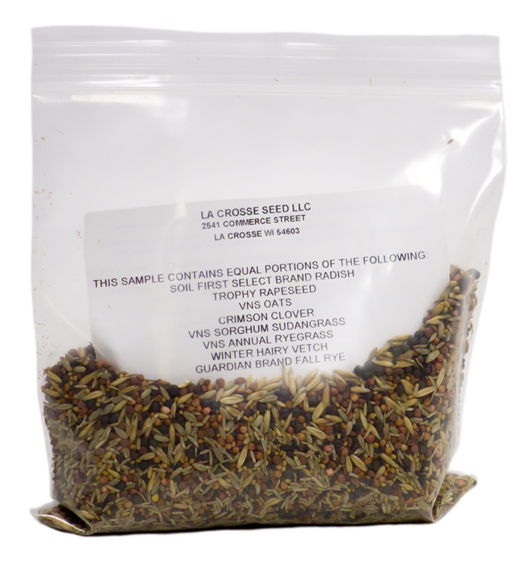
Soil herbicide bio-assay
Test for residuals – costly & time consuming
Check germination of different seeds
Collect soil (approximately 1-6” depth)
Seed small area or corner of field
Use seeds that tend to signal potential herbicide injury
OATS & CEREAL RYE
RADISH
CRIMSON CLOVER, WINTER HAIRY VETCH, WINTER PEAS
ANNUAL RYEGRASS & SORGHUM SUDANGRASS

